Slide 2
Once upon a time…

Slide 3
Theodore Ratisbonne
Notes:
Catholic foundation (NOT a catholic school)
Alphonse and Theodore

Slide 4
Sion’s story begins
1843
First Sisters of Our Lady of Sion
“The outstanding feature of the work of Our Lady of Sion must be the love of Jesus for the Jewish people.”

Slide 5
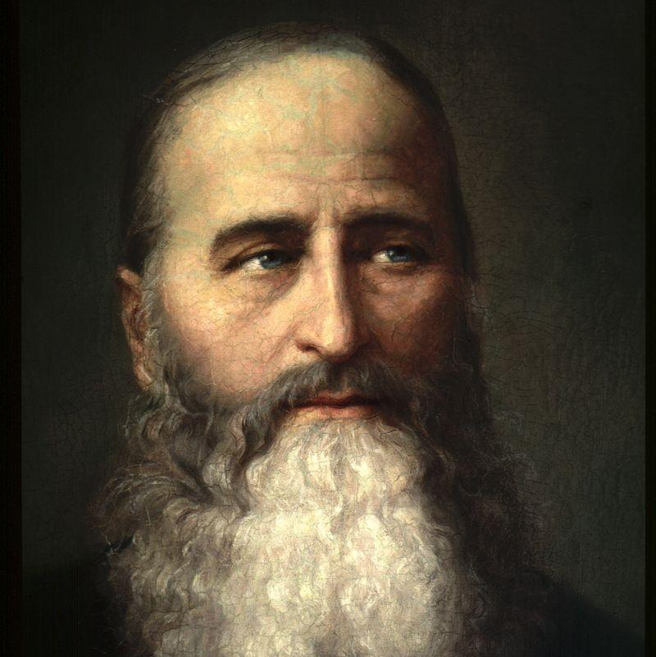
Ratisbonne Brothers
Notes:
Catholic foundation (NOT a catholic school)
Alphonse and Theodore

Slide 6
Consideration Always
Central to our School life
Celebrate unique spirit and achievement of every person here.
Notes:
We take pride in working together to ignite the highest aspiration, celebrating the unique spirit and achievement of every child and colleague.
Under our care, the next generation of Sionians discover possibilities in the world around them, develop a life-long passion for learning and respond willingly and with compassion to the needs of others.

Slide 7
Sion charism
Gifts of grace,
Serving others
Notes:
Charism means – gifts of grace/serving others.

Slide 8
Recognition
Academic effort
Sion Spirit
Community Outreach
Leadership
Notes:
There are four main areas of recognition:
Students receive a Sion Spirit Award when they demonstrate actions that are associated with our school motto (Consideration Always) and our school ethos.
Students receive a Community Outreach Award when they voluntarily give of their time and/or talents to serve others in their community.
When you feel you are developing your:
leadership skills,
self-discipline,
sense of responsibility
emotional resilience
talk to your teacher about it and we will take record of it.

Slide 9
Notes:
Form tutors to gather info from students about any good works they have done. Acts of Random Kindness, Make it a formal requirement and log. Any effort they have put in, any times they’ve stood up for someone etc. Any time they’ve had someone support them.
Pay it Forward

